Slide 1


DIASPOCARE TPRM SECURITY POSTURE COMPARISON
A Comparative Analysis of Splunk and SquadCast

Slide 2
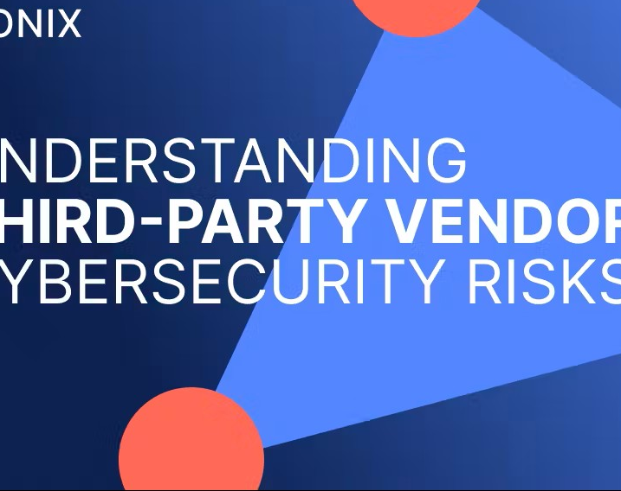
AGENDA
•Background and Definition of TPRM
•Overview of Splunk and SquadCast
•Methodology: TPRM Questionnaire
•Key Findings: Security Practices Comparison
•Detailed Analysis
•Recommendations
•Q & A

Slide 3
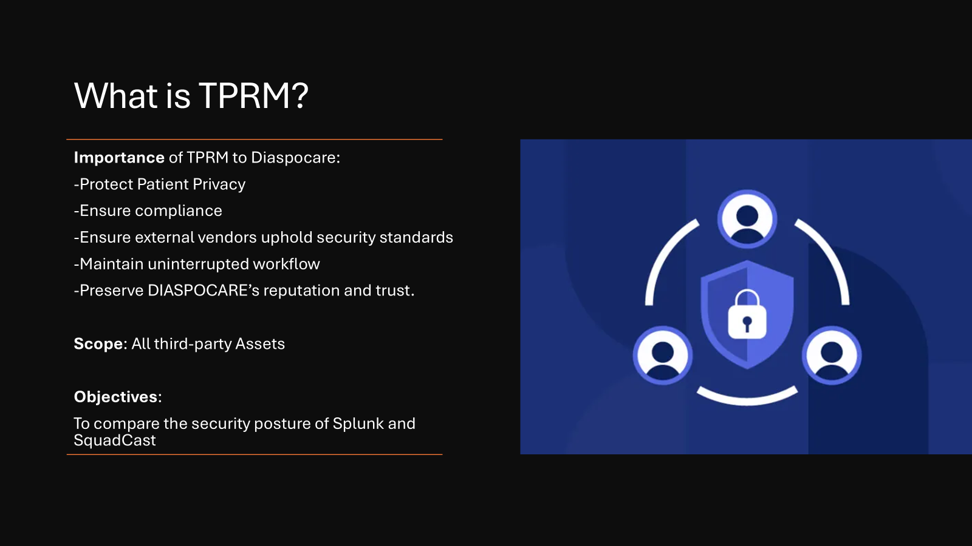

Slide 4
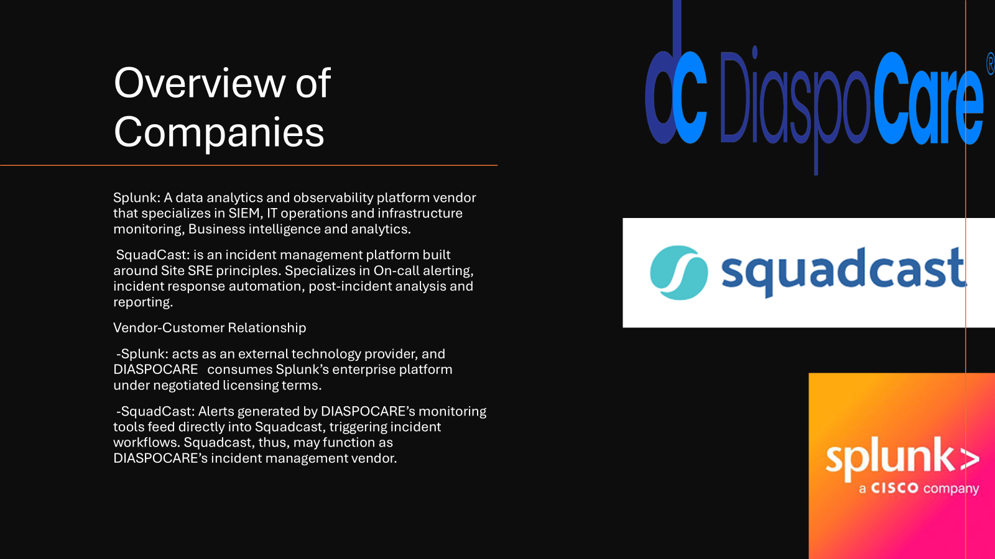

Slide 5
Methodology
Overview of the Assessment Approach
This assessment is based on a standardized Third-Party Risk Management (TPRM) questionnaire, designed to evaluate vendors' security postures across critical domains.
The questionnaire is structured to ensure consistency, transparency, and comparability across vendors.
Areas Covered in the Questionnaire
The TPRM covers a wide range of security and compliance topics, grouped into key risk domains:
Organizational Security – governance, policies, employee awareness
Data Protection – encryption, access control, data classification
Incident Response – detection, response planning, recovery
Compliance & Regulatory – adherence to standards like ISO, SOC2, GDPR
Assessment Criteria
Each question is scored using a risk-based scale:
0 = No Risk (🟢 Green)
1 = Low Risk (🟡 Yellow)
2 = Medium Risk (🟠 Orange)
3 = High Risk (🔴 Red)
Scoring and Normalization
The maximum possible score is 162 (i.e., if every question scored 3).
To allow fair comparison, we calculate a Normalized Score using the formula: Normalized Score = (Vendor IRQ Score / Max Possible IRQ Score) × 100%.
Risk Level Thresholds
0–53 → 🟢 LOW Risk → Considered for Approval
54–107 → 🟠 MEDIUM Risk
108–162 → 🔴 HIGH Risk

Slide 6
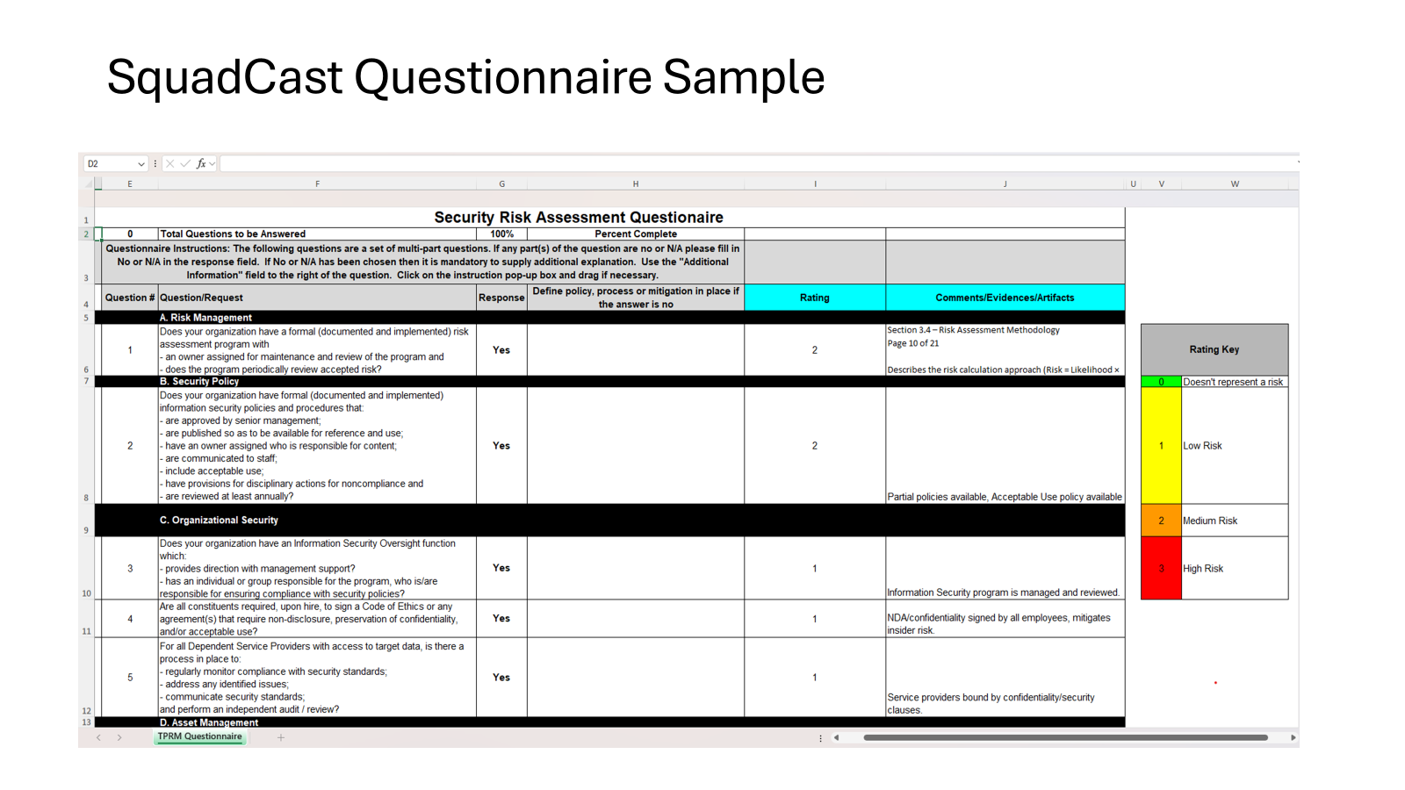

Slide 7
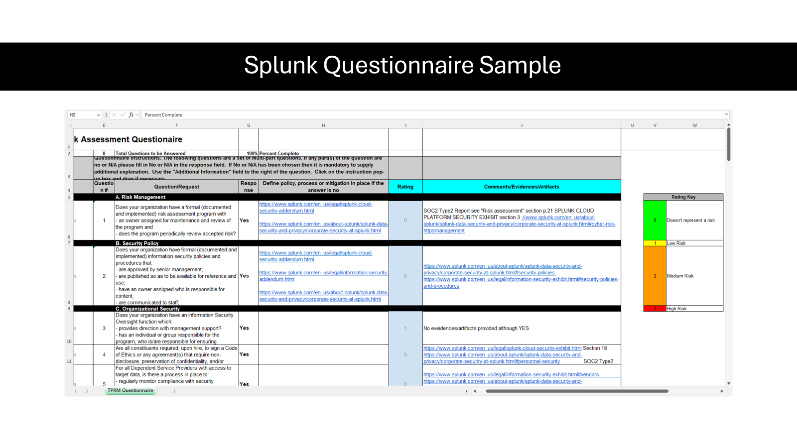

Slide 8
Summary Of Key Findings
High-Level Comparison of Key Security Practices:
SquadCast shows solid practices but with some gaps in documentation and implementation evidence.
Both vendors demonstrate strong security postures.
Splunk consistently scores slightly higher across most categories, reflecting more mature and well-documented practices.

Slide 9
Organizational Security
Security Policies and Governance
Squadcast has documented policies, but some are inferred from certifications like ISO 27001 and SOC2. Acceptable Use Policy exists, though ownership and review cycles are unclear.
Splunk provides detailed, publicly accessible policies. These are approved by senior management, reviewed annually, and include disciplinary provisions.
Employee Training and Awareness
Squadcast provides GDPR and security training at onboarding. Employees sign NDAs and confidentiality agreements.
Splunk offers structured onboarding and continuous training. Background checks cover employment, criminal, academic, and drug screening.
Comparison
Splunk demonstrates a more mature and transparent governance structure, with comprehensive documentation and rigorous employee vetting. Squadcast is compliant but leans more on external certifications than internal policy maturity.

Slide 10

Data Protection
Data Encryption and Anonymization
Both vendors encrypt data at rest and in transit.
Squadcast lacks detailed documentation on anonymization.
Splunk follows SOC 2 and ISO standards with detailed encryption policies.
Access Controls
Both vendors implement role-based access, unique IDs, and periodic reviews.
Splunk provides more evidence of enforcement and policy maturity.
Comparison
Splunk leads slightly due to stronger documentation and broader scope of controls.

Slide 11
Incident Response
Incident Detection Capabilities
SquadCast: Has an incident response plan aligned with SOC2 and ISO.
Splunk: Uses the Splunk Incident Response Framework (SIRF), with annual reviews and breach notification protocols.
Response Procedures and Recovery Plans
Both vendors have formal plans.
Splunk includes detailed roles, testing, and client notification procedures.
Comparison
Splunk demonstrates a more structured and proactive approach to incident response.

Slide 12



Compliance and Regulatory
Tailored Security Improvements
Risk Mitigation Strategies
Monitoring & Re-evaluation
Build IS documentation, renew ISO 27001 certification
Obtain SOC2 Type II Report, align with GDPR and PCI DSS
Provide TPRM report and cloud/vendor documentation
Submit artifacts for data protection and network security
Identify potential exceptions
Use follow-up questionnaires and due diligence
Consult upper management for exception decisions
Notes:
Hamdiya

Slide 13
Key Findings
Summary of Findings
Splunk: Strong TPRM posture, low-risk, well-documented
SquadCast: Moderate risk, lacks evidence in data/network security
Next Steps in TPRM Process
Meet with Upper Management for Splunk onboarding decision
Call to Action
Advise Procurement, Legal, and Business on Splunk approval
SquadCast must complete follow-up with evidence submissions
Notes:
Hamdiya

Slide 14

Risk Assessment Summary
Squadcast
Higher risk in Background Screening, Incident Response, Vulnerability Management
Requires continuous monitoring and reassessment
Splunk
Consistent low-risk across all domains
Suitable for high-security environments
Impact
Squadcast may increase compliance, operational, and reputational risk
Splunk better aligned with organizational security objectives
Notes:
Hamdiya

Slide 15
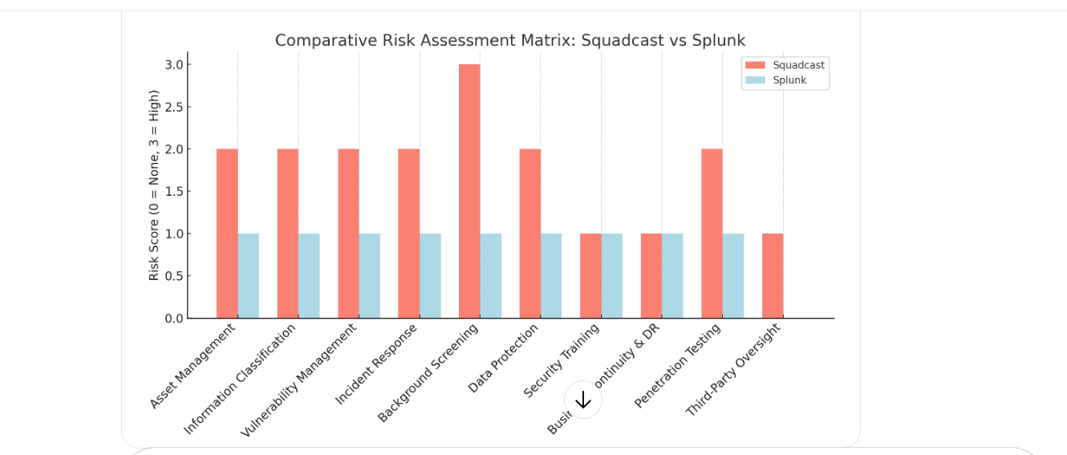
Risk Assessment Matrix

Slide 16

Security Enhancements & Risk Mitigation
Tailored Security Improvements
Renew ISO 27001, SOC2 Type II, align with GDPR & PCI DSS
Build and document IS policies and network controls
Risk Mitigation Strategies
Provide documented TPRM and vendor/cloud provider evidence
Submit security artifacts on data protection and network segmentation
Monitoring & Re-Evaluation
Reassess high-risk areas via follow-up questionnaires
Perform due diligence and align with procurement/business strategy
Notes:
Hamdiya

Slide 17
Final Recommendation Summary
Splunk demonstrates a strong and mature cybersecurity posture across all key domains.
Squadcast reveals moderate risk due to gaps in incident response, vulnerability management, and background screening.
For Diaspora Care, which handles sensitive personal and possibly health-related data, Splunk provides better assurance.
✅ Recommended: Proceed with Splunk as the preferred third-party provider.

Slide 18


